Slide 1

Fire Watch - Update
Using Convolutional Neural Networks to Prevent Wildfires
Carter Elliott & Steven Nguyen in Partnership with Perimeter Platform

Slide 2
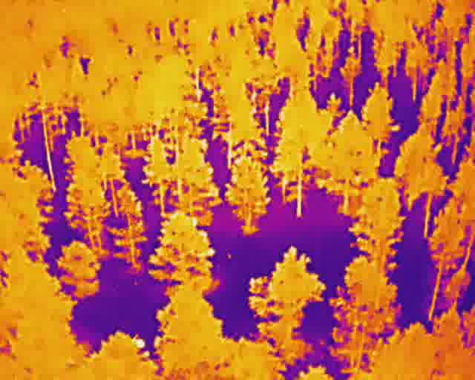
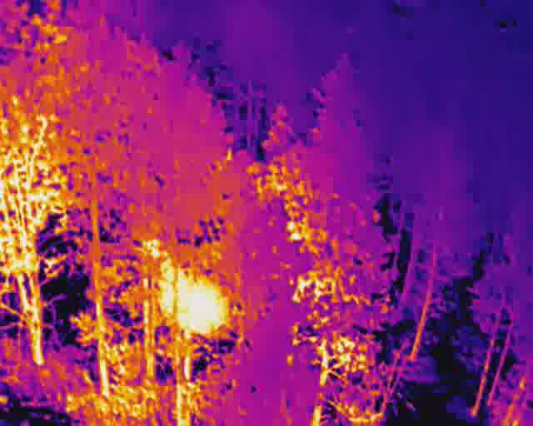
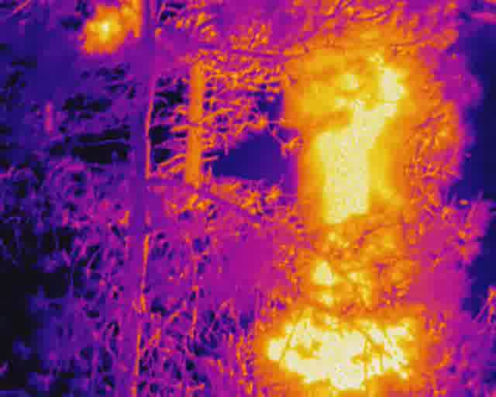
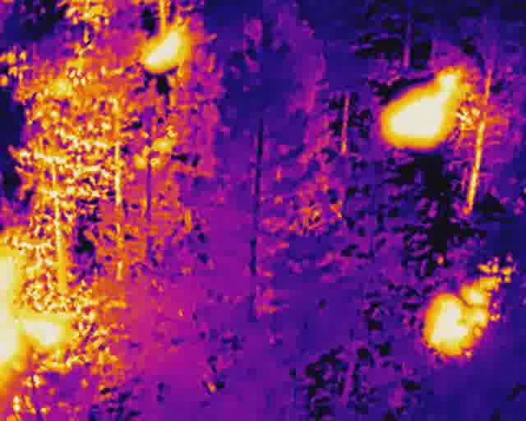
A Quick Refresher...
Convolutional Neural Networks (CNN) can be used to classify fires, which can be used to detect and alert others about small fires before the become infernos
Data gathered from the FLAME Dataset can be used to train a model to identify different sized fires using thermal images extracted from a thermal video
no_fire
small_fire
large_fire
multiple_fires

Slide 3

Machine Learning Checklist
Frame the problem and look at the big picture
Get the data
Explore the data to gain insights
Prepare the data to better expose underlying patterns to ML algorithms
Explore many different models and short list the best ones
Fine tune models and combine to make great solution
Present the solution
Launch, monitor, and maintain the system

Slide 4
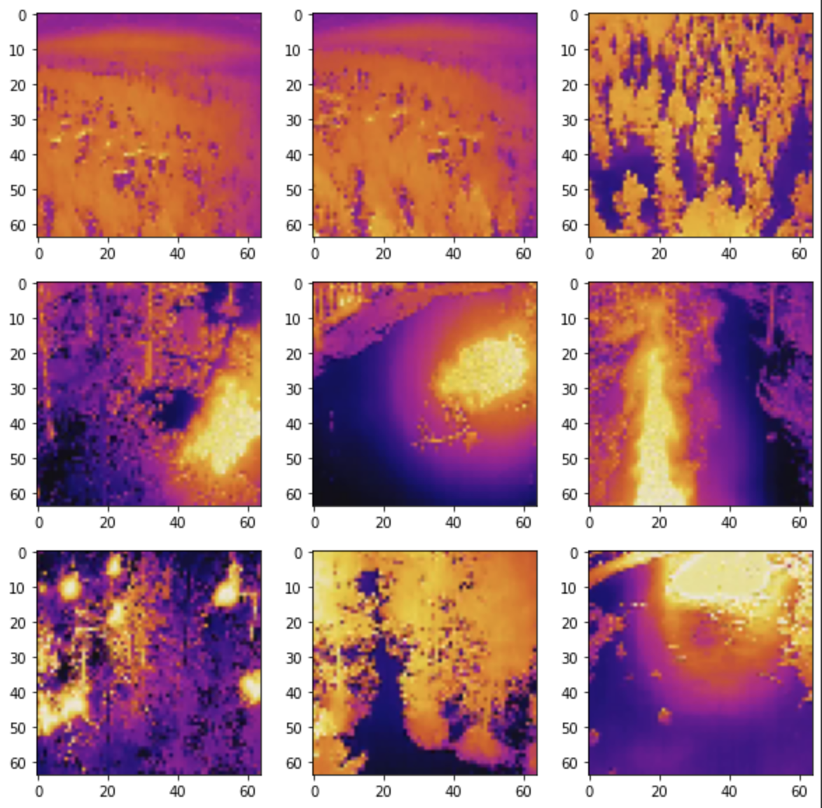
Let’s Take A Look...
*First 9 Images of the Training Set*
No Fires (Images 1, 2, 3, 8)
Funky shapes/outlines
Majority orange, pink, purple
Funky shapes (environment)
Clearly defined “cold spots”
Small Fires (Images 4, 5)
Small bright spot
Irregular shapes
Large Fire (Images 6, 9)
Very clear bright spot
Very clear shapes
Multiple Fires (Image 7)
Multiple tiny dots
Clear shapes for fires
Irregular shapes for environment

Slide 5
Preparing the Dataset (FIRE)
Fix the “Batch Dataset” size
Dataset was created in batches - small segments of the dataset
We modified the batch size from 12 to 10,000 so that all the data was in one batch
Image and Label Conversion
Convert the dataset into a NumPy-Based System
Researched and Executed Code to Convert (see Colab Notebook)
Reconstruct the Training/Testing Sets with Grayscale Images
Used code from previous labs to grayscale the Training/Testing Sets
Checked for completion by calling the shapes using the .shape argument
Expose the Grayscale Training/Testing Sets to Model
See Colab Notebook

Slide 6
Explore Many Different Models
Model 1: VERY POOR Accuracy (39.81%)
Model 2: Zero Padding on Convolutional Layer #1 increased accuracy (43.82%)
Model 3: New Kernel Size (6, 6) on Convolutional Layer #1 and Smaller Validation Split (0.1) increased accuracy (46.29%)
Model 4: Zero Padding on Convolutional Layer #2 decreased accuracy (45.70%)
Model 5: New Kernel Size (4, 4) on Convolutional Layer #2 decreased accuracy slightly (45.58%)
Model 6: Introduction of Learning Rate (0.1) increased accuracy slightly (45.70%)
Models 7 & 8: Modification of Learning Rate kept accuracy neutral (45.70%)
Model 9: Changing Number of Layers on Dense Layer #2 (10 to 4) kept accuracy neutral (45.70%)
https://docs.google.com/spreadsheets/d/14GAvady1-Ao20qM3-EMf-2xQ3vZ-pDyS5zsBr4kTkq8/edit?usp=sharing

Slide 7
Colab Notebook Demo:
https://colab.research.google.com/drive/1IURan__-glEq4jqfuWz9o3evef9NxvDj?usp=sharing

Slide 8
Issues (11/16/21 - 11/30/21)
We can’t get our model accuracy above 45.70%
Model is making incorrect predictions (images are not matching with the classes)

Slide 9
Milestones Accomplished (11/16/21 - 11/30/21)
Converted the Batch Dataset into a NumPy-Based Dataset
Split the Dataset into Training and Testing Datasets
Converted Dataset to Grayscale and Normalized the Dataset
Created the “Model Blueprint”
Ran a successful first test (with no explosions!) and got a baseline accuracy
Created a document that has each model’s characteristics
Employed multiple different runs and got an improved accuracy

Slide 10
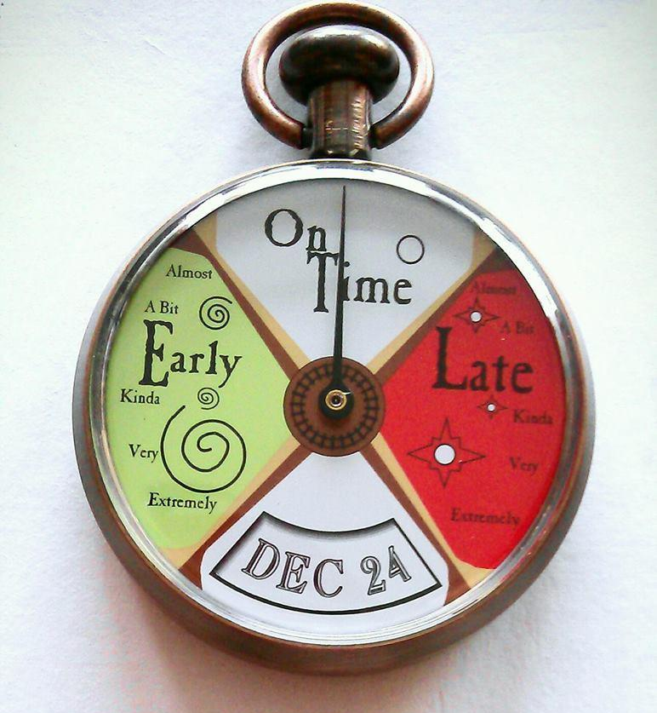
Milestones Missed (11/16/21 - 11/30/21)

Slide 11
Milestones Planned (11/30/21 - 12/7/21)
Continue to experiment and refine the model with different parameters (additional layers, compilers, learning rates, etc.)
Improve the Training and Validation Accuracies (Seen in plots)
Create different CNN with different parameters (different filter sizes, layer amounts, strides, zero padding, etc.) and document models that worked best
Send an update to Perimeter (once accuracy reaches more than 50%)

Slide 12
Areas/Questions for Discussion + Research
Technical Research Question (TRQ)
What is the most important parameter when creating a CNN?
What is the purpose of each layer in a CNN algorithm? (Review)
Do certain layers have more of an impact than others?
What is the process for uploading a model to AWS?
General Research Questions (GRQ)
How have Convolutional Neural Networks been used for firefighting in the past?
Have any Convolutional Neural Networks for firefighting been used in the real world?
What impact would this kind of technology have on the firefighting landscape?

